Slide 1

Housing for Health Partnership:
Community Meetings - Action Plan Updates
January 31, 2024
February 6, 2024
February 7, 2024

Slide 2
Welcome and Agenda
Agenda
Welcome
Updating Action Plans + Background (15-20 minutes)
Community Input Process (1.5 hours)
Wrap-Up/Summary (5-10 min.)

Slide 3
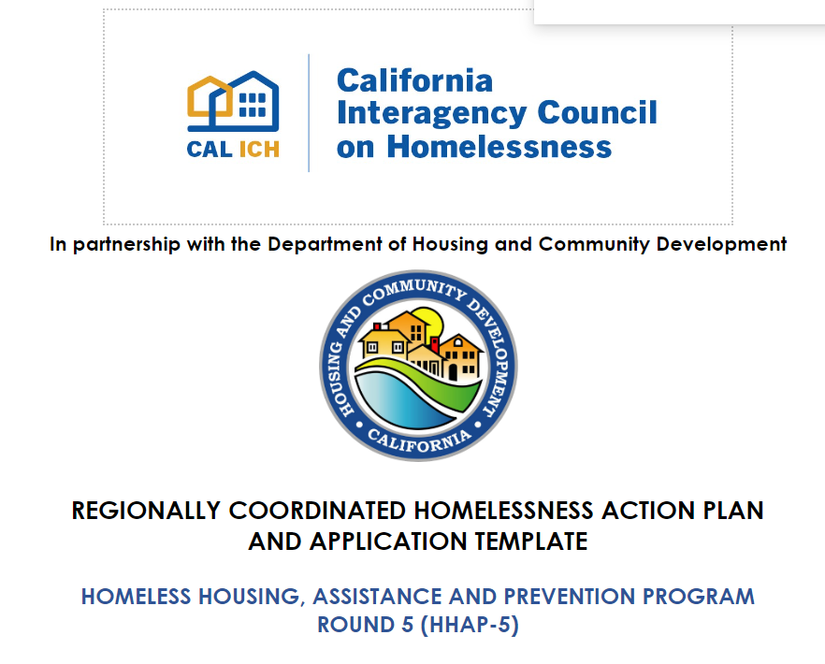
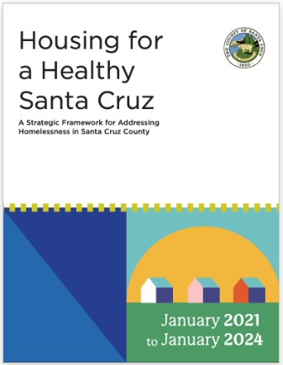
Creating and Updating Local Action Plans
Notes:
3 bullets of major accomplishments…..Increased permanent housing, reduced # of people experiencing homelessness, improved system/backbone (HMIS and CE)

Slide 4
State Block Grants To Address Homelessness:
Santa Cruz County and CoC

Slide 5
Funding Overview: Average Costs
Outreach team serving 100 people at a time
100 emergency shelter beds
year-round
100 rapid
rehousing
100 permanent supportive housing slots
$720,000
PER YEAR
$3.65 Million
PER YEAR
$3.2 Million (time-limited)
PER YEAR
$3.2 Million
(ongoing)
PER YEAR
Housing for Health Budget = $21.7M in FY 23-24; Current Framework needs $78M/year to implement

Slide 6
CalAIM (California Advancing and Innovating Medi-Cal)
For individuals enrolled in Medi-Cal (Medicaid)
Undocumented individuals eligible for Medi-Cal – January 2024
Enhanced Care Management ($625PMPM) – adults experiencing homelessness with at least one complex physical, behavioral, or developmental need or children/families experiencing unstable housing/homelessness
Housing Community Supports ($386 or $444PMPM) + Security Deposits ($5,000 one-time) – Medi-Cal members experiencing/at-risk of homelessness
Paid for outreach and connection; per-member, per-month; can do ECM and Housing together with one team

Slide 7
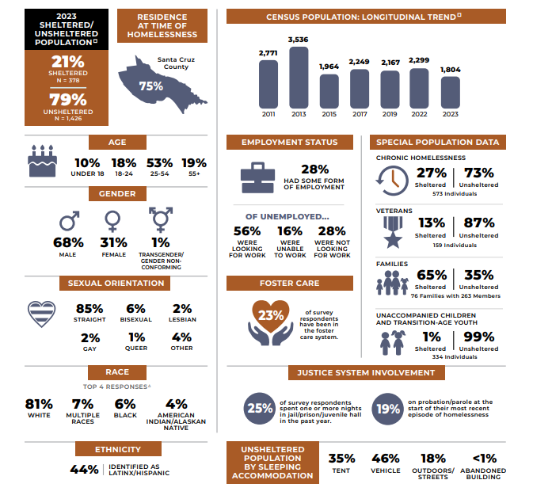

Slide 8
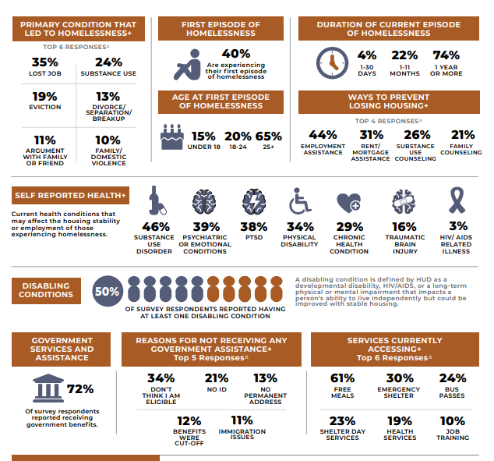

Slide 9
Racial and Ethnic Disparities – How to Address Them?
Native Americans, Black/African Americans - overly represented among people experiencing homelessness
Hispanic/Latino/a/x – 2023 count – first time overly represented; significant disparities with families with children<18
Hispanic/Latino/a/x – less likely to access coordinated entry and shelter
Hispanic/Latino/a/x – more likely to exit programs to permanent housing
Whites, non-Hispanic – more likely to get into PSH, more likely to exit back to homelessness

Slide 10
Community Input Process
5 “Musical tables” – 15 minutes per session - assigned one table to start
4 Transition/Breaks – 5 minutes
1 “Small $ and Big Impact” ideas wall
“Bingo” Card – get sign-off from facilitator at each table for gift at end of meeting if visit all tables
Not required to visit all tables, spend more time at some if desired
10 dots/person to express support for a proposed action

Slide 11
Community Input - Guidelines
No idea is a bad idea
Briefly express your idea (3-7 words as an action step written on paper); brainstorm for your self first (notes on your “bingo” card)
Give everyone at table a chance to contribute
Review prior group ideas to avoid duplicates when possible; put your dot on ideas you really support (only 10 dots/person)
Limited new dollars available - think of ideas that can generate more resources or make existing resources more impactful
Remember sub-populations in your ideas (veterans, youth, families, seniors and people with disabilities, working-age adults, those fleeing domestic violence, etc.)
Racial/ethnic disparities – how to address them

Slide 12
Community Input - Stations
Table 1 – Improving access (connections), outreach, response to unsheltered
Table 2 – Keep housing and avoid homelessness (prevention)
Table 3 – Help more people secure temporary shelter and permanent homes more quickly (housing pathways)
Table 4 – Reducing exits into homelessness from institutions – criminal justice, health, foster care
Table 5 – Increasing incomes – public benefits, education, and employment
Small cost and big impact ideas not already shared (poster)
Improving and coordinating services for youth at-risk of or experiencing homelessness (special table/poster)

